Slide 1

Cufflink
Zuri Wong, Joe Chu, Christian Howe

Slide 2
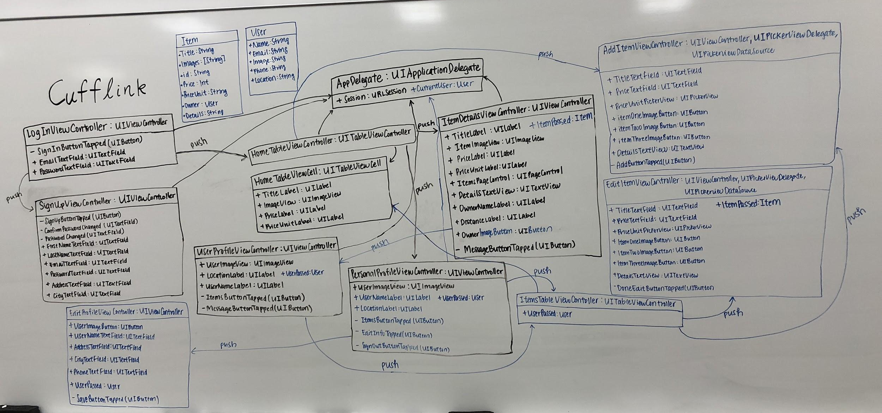
UML Class Diagram
Notes:
Here is our Home Scene,
When user sign up at Cufflink, user is established as a borrower, as user comes into the home view, as you can see at the top right corner, user have the option to become a borrower by adding his/her first item..
Let’s take a look at the home Scene for a second,
Here as you can see, for each row of the table view, there is an an image of the suit, then a heading for an overview of the product, then there’s the pricing.
Price can be adjusted from x amount of dollars per hour to x amount of dollars per day based on the suit-supplier liking
Now let’s take a look at the Item Detail View.

Slide 3
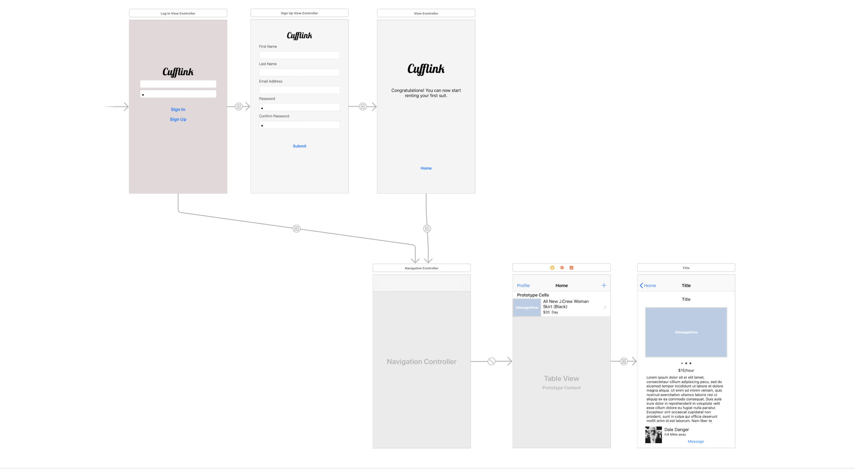
Navigation Structure From last week
LogInViewController
SignUpViewController
ItemDetailsViewController
HomeTableViewController
Notes:
Here is our Home Scene,
When user sign up at Cufflink, user is established as a borrower, as user comes into the home view, as you can see at the top right corner, user have the option to become a borrower by adding his/her first item..
Let’s take a look at the home Scene for a second,
Here as you can see, for each row of the table view, there is an an image of the suit, then a heading for an overview of the product, then there’s the pricing.
Price can be adjusted from x amount of dollars per hour to x amount of dollars per day based on the suit-supplier liking
Now let’s take a look at the Item Detail View.

Slide 4
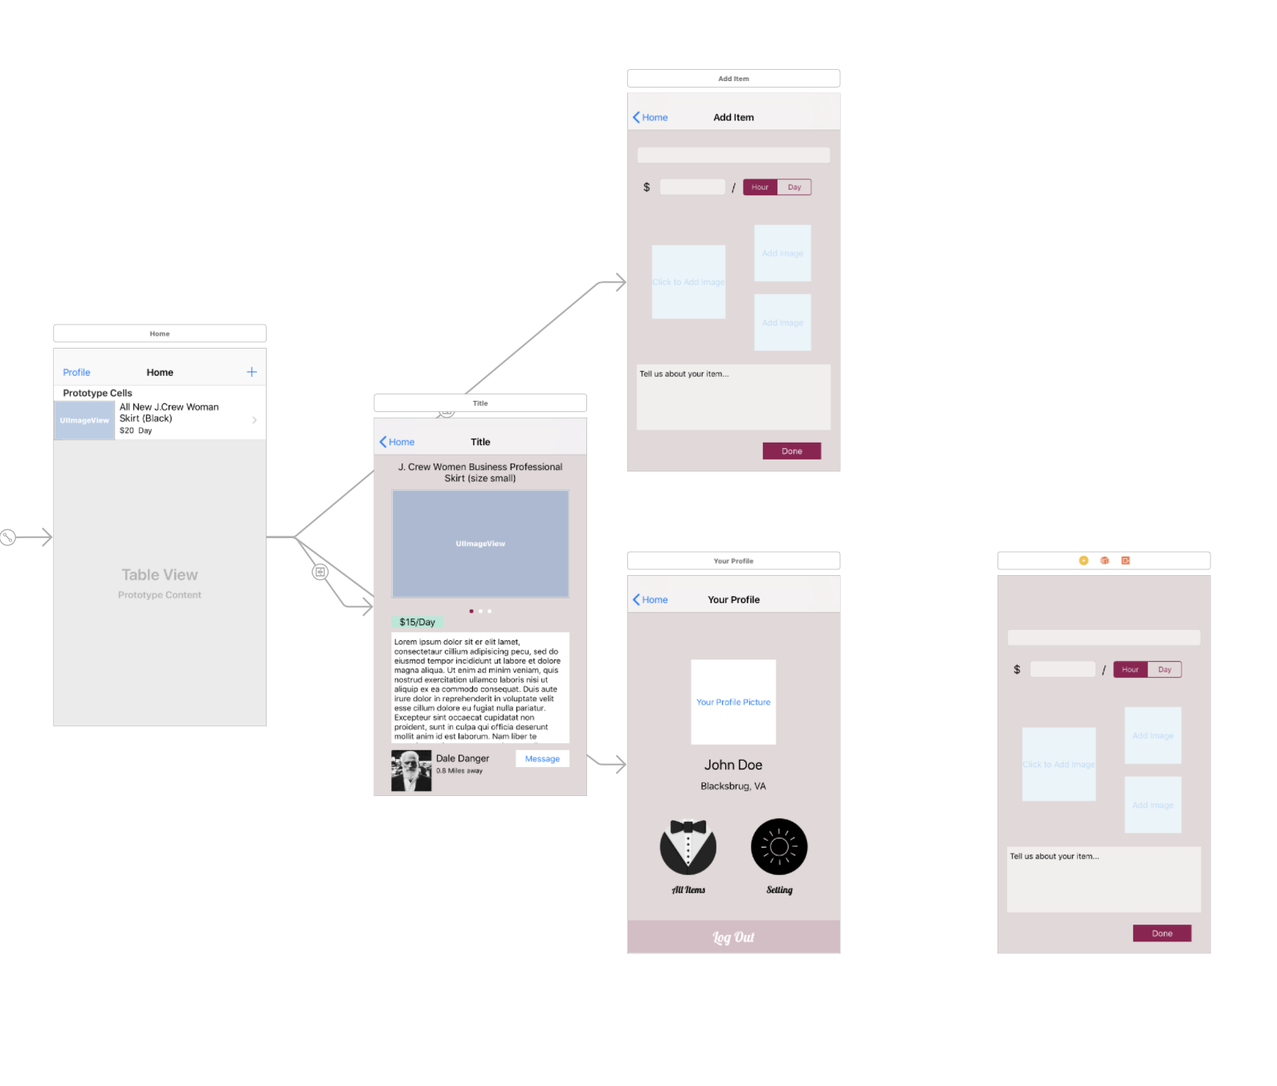
Navigation Structure expanded
AddItemViewController
EditItemViewController
PersonalProfileViewController
Notes:
Here is our Home Scene,
When user sign up at Cufflink, user is established as a borrower, as user comes into the home view, as you can see at the top right corner, user have the option to become a borrower by adding his/her first item..
Let’s take a look at the home Scene for a second,
Here as you can see, for each row of the table view, there is an an image of the suit, then a heading for an overview of the product, then there’s the pricing.
Price can be adjusted from x amount of dollars per hour to x amount of dollars per day based on the suit-supplier liking
Now let’s take a look at the Item Detail View.

Slide 5
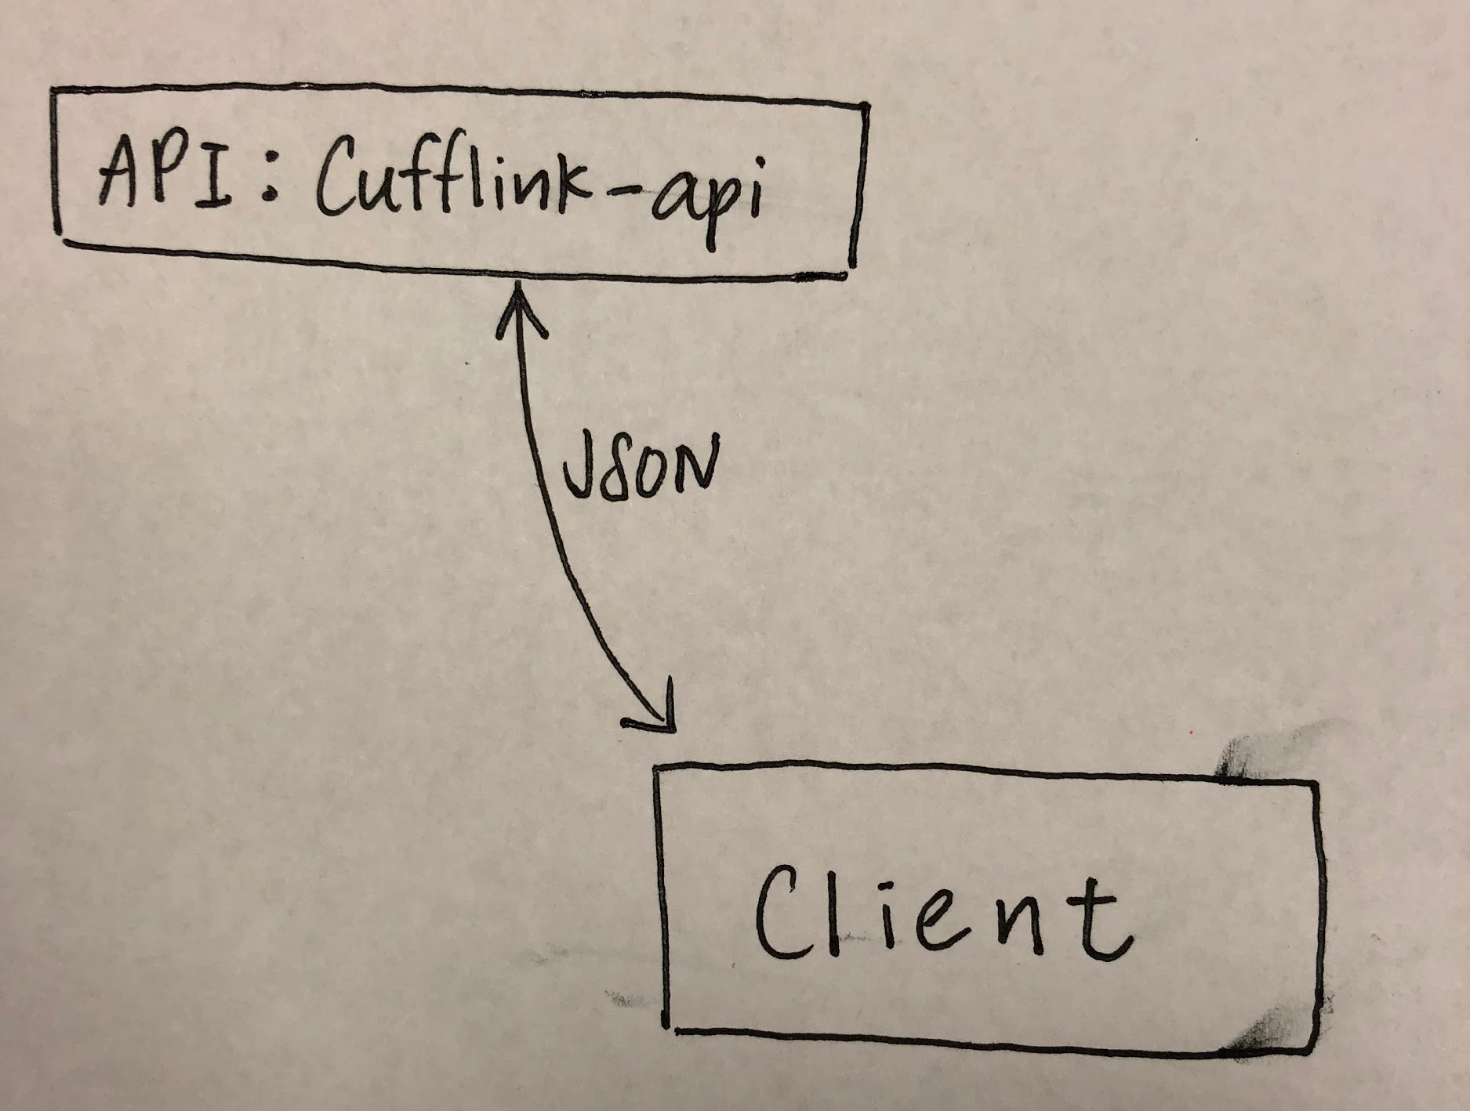
Architecture Specification
The system is built using a client server architecture with a custom JSON API. The API has endpoints for authenticating users, signing up new accounts, creating formal wear posts, listing formal wear posts, and getting details about formal wear posts and users. It uses a token for authentication, which is shared via URLSession.
Notes:
Here is our Personal Profile View.
Each user will have their own personal profile view.
The Personal Profile View is used to view your own information and postings.
In the Personal Profile View, instead of an items and message buttons, they are replaced with a your items button and an edit info button respectively.

Slide 6
API Used So Far
Login
cufflink-api.now.sh/login
Provide a JSON document with the username and password
Get a login token to provide with other requests
Signup
cufflink-api.now.sh/signup
Provide a JSON document with the signup info from the UI
Get all items (includes general info of items)
cufflink-api.now.sh/items
Get item (full details of an item using item ID)
cufflink-api.now.sh/items/1
Get current location of user given address/zipcode (geocoding)
Latitude and longitude
Notes:
Here is our Personal Profile View.
Each user will have their own personal profile view.
The Personal Profile View is used to view your own information and postings.
In the Personal Profile View, instead of an items and message buttons, they are replaced with a your items button and an edit info button respectively.

Slide 7
Functional Requirements
The software system shall enable the user to find formal wear available for rent from other users.
The software system shall enable the user to post formal wear with images, textual description, availability, and rental price.
The software system shall enable the user to contact other users for the purpose of discussing the rental of formal wear.
The software system shall enable the user to create a profile that includes personal information necessary for the rental of a suit, including a name and general location.
Notes:
Here is our Personal Profile View.
Each user will have their own personal profile view.
The Personal Profile View is used to view your own information and postings.
In the Personal Profile View, instead of an items and message buttons, they are replaced with a your items button and an edit info button respectively.

Slide 8
Functional Requirements Cont.
The software system shall enable the user to authenticate with a username and password.
The software system shall enable the user to set up authentication information, including a unique username and a password of at least 8 characters.
The software system shall enable the user to see their geographical distance from another user and only show suits in that range.
The software system shall enable the user to see their own profile and the profile of other users.
The software system shall enable the user to change the availability of their formal wear when it is rented out.
Notes:
Here is our Personal Profile View.
Each user will have their own personal profile view.
The Personal Profile View is used to view your own information and postings.
In the Personal Profile View, instead of an items and message buttons, they are replaced with a your items button and an edit info button respectively.

Slide 9
Non-Functional Requirements
The software shall use a custom API to securely and privately share data between users.
The software system shall protect the privacy of a users’ exact address.
The software system shall perform responsively while network requests are in progress.
The software system shall be developed with resources available royalty free online.
The software system shall run on iPhone SE to iPhone X in portrait mode only.
The software system shall be self-explanatory to use without instruction.
Notes:
Here is our Personal Profile View.
Each user will have their own personal profile view.
The Personal Profile View is used to view your own information and postings.
In the Personal Profile View, instead of an items and message buttons, they are replaced with a your items button and an edit info button respectively.

Slide 10
Roadblocks so far...
Access data from API in a time sensitive manner
< 1 second
Generating useful data for testing purposes
Large amount of examples are needed
Keeping API in sync with front end
Doing multiple deploys and using the right deploy in app
Notes:
Here is our Personal Profile View.
Each user will have their own personal profile view.
The Personal Profile View is used to view your own information and postings.
In the Personal Profile View, instead of an items and message buttons, they are replaced with a your items button and an edit info button respectively.

